Slide 1
Chapter 1
Basic Concept Programming

Slide 2
Objectives (1 of 2)
In this chapter, you will:
  Learn about different types of computers
  Explore the hardware and software components of a computer system
  Learn about the language of a computer
  Learn about the evolution of programming languages
  Examine high-level programming languages
  Discover what a compiler is and what it does

Slide 3
Objectives (2 of 2)
  Examine a C++ program
  Explore how a C++ program is processed
  Learn what an algorithm is and explore problem-solving techniques
  Become aware of structured design and object-oriented design programming methodologies

Slide 4
Introduction
Without software, a computer is useless
Software is developed with programming languages
  C++ is a programming language
C++ is suited for a wide variety of programming tasks

Slide 5
A Brief Overview of the History of Computers (1 of 3)
The computers that we know today use the design rules given by John von Neumann in the late 1940s.
His design included components such as an arithmetic logic unit, a control unit, memory, and input/output devices.
Can you imagine how computer process the data?

Slide 6
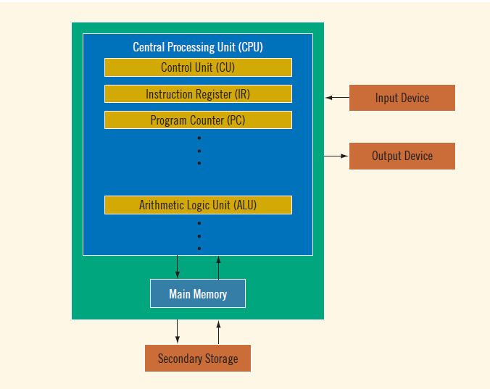
A Brief Overview of the History of Computers (2 of 3)
How computer work

Slide 7
A Brief Overview of the History of Computers (3 of 3)
Computers can be found anywhere from the size of a desktop to smaller than the palm of one’s hand such as desktop computers, notebooks, netbooks, tablet PCs and mobile devices. Many kinds of applications or apps can be downloaded into the tablet or smartphone.
There are many ways to develop these applications.
    Some websites provide templates to create apps quickly
    Users with programming knowledge can create their apps from scratch.
Examples of systems/apps developed using programming language:
    Automated Teller Machine (ATM) systems,
    Student Information Systems
    Online Ticketing Systems

Slide 8
The Language of a Computer (1 of 3)
Electrical Signals (ES) are used inside the computer to process information. There are two types of (ES)
  Analog signals: continuously varying continuous wave forms such as (sound (Audio tapes))
  Digital signals: information with a sequences of 0s and 1s (0 represent for low voltages, 1 represent for high voltages)
Language of a computer used to processed Digital signals called Machine language (A sequence of 0s and 1s)
  Binary digit (bit): the digit 0 or 1
  Binary code (binary number): a sequence of 0s and 1s

Slide 9
The Language of a Computer (2 of 3)
TABLE 1-1 Binary Units
Unit | Symbol | Bits/Bytes
Byte |  | 8 bits
Kilobyte | KB | 2¹⁰ bytes = 1024 bytes
Megabyte | MB | 10²⁴ KB = 2¹⁰ KB = 2²⁰ bytes = 1,048,576 bytes
Gigabyte | GB | 10²⁴MB = 2¹⁰ MB = 2³⁰ bytes = 1,073,741,824 bytes
Terabyte | TB | 10²⁴ GB = 2¹⁰ GB = 2⁴⁰ bytes = 1,099,511,627,776 bytes
Petabyte | PB | 10²⁴ TB = 2¹⁰ TB = 2⁵⁰ bytes = 1,125,899,906,842,624 bytes
Exabyte | EB | 10²⁴ PB = 2¹⁰ PB = 2⁶⁰ bytes = 1,152,921,504,606,846,976 bytes
Zettabyte | ZB | 10²⁴ EB5 2¹⁰ EB = 270 bytes = 1,180,591,620,717,411,303,424 bytes

Slide 10
The Language of a Computer (3 of 3)
Byte: a sequence of eight bits
Kilobyte (KB): 2¹⁰ bytes = 1024 bytes
ASCII (American Standard Code for Information Interchange)
  A is encoded as 1000001
  The character 3 is encoded as 0110011
  Number systems
    The decimal system (base 10) is used in our daily life
    The computer uses the binary (or base 2) number system

Slide 11
The Evolution of Programming Languages (1 of 4)
Assembly language instructions are mnemonic
  Instructions are written in an easy-to-remember form
An assembler translates a program written in assembly language into machine language
Using assembly language instructions, wages = rate * hours can be written as:
  LOAD rate
  MULT hours
  STOR wages

Slide 12
The Evolution of Programming Languages (2 of 4)
High-level languages include Basic, FORTRAN, COBOL, C, C++, C#, Java, and Python
Compiler: translates a program written in a high-level language into machine language
In C++, the weekly wages equation can be written as:
wages = rate * hours;

Slide 13
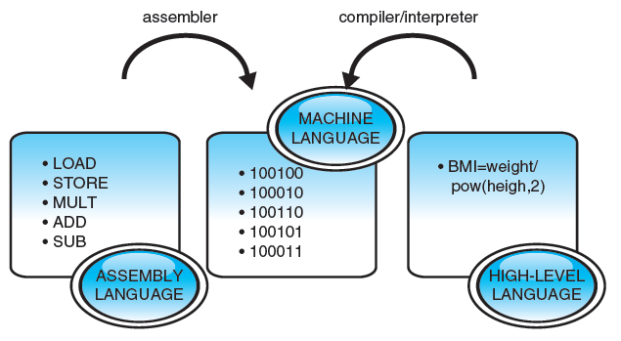
The Evolution of Programming Languages (3 of 3)
Example:
To calculate the BMI of a user given the formula:

Slide 14
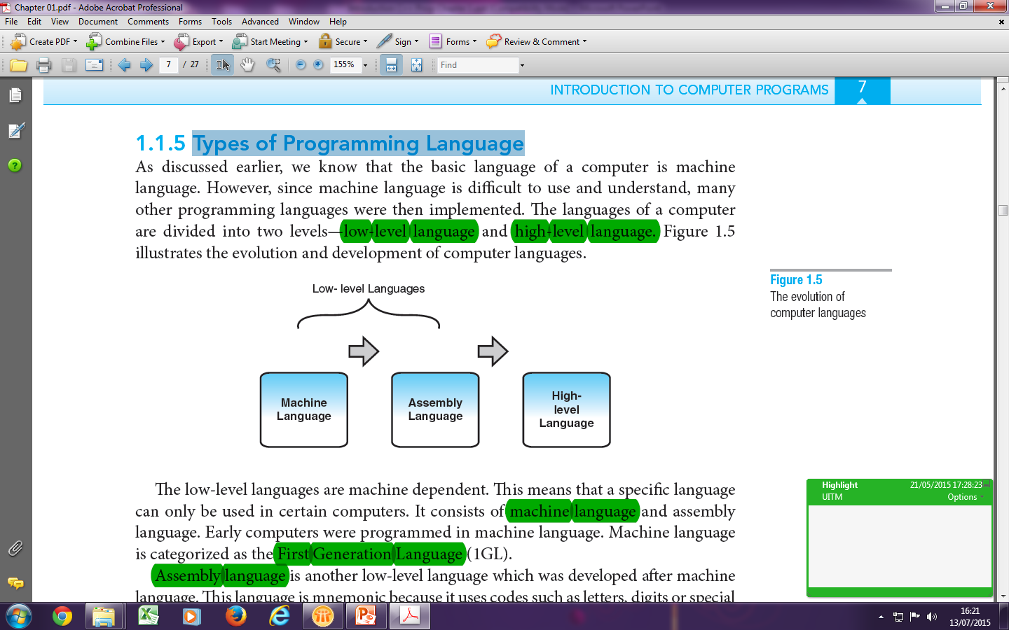
The Evolution of Programming Languages (4 of 4)
Language is mnemonic
Use assembler as translator to translate to machine language
Machine independent
The instructions are quite English-like
Use compiler/interpreter as translator to translate to machine language
Example: JAVA, C++, COBOL

Slide 15
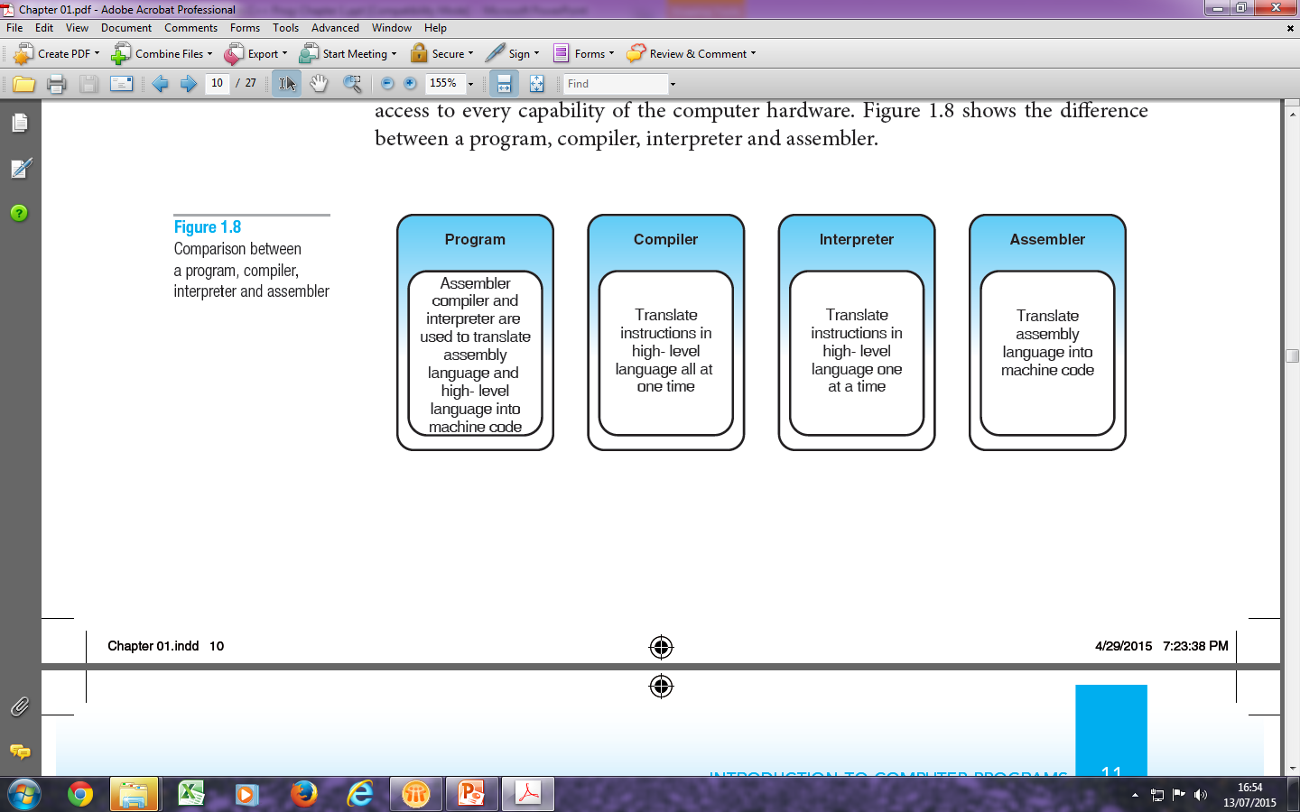
Processing a C++ Program (1 of 12)
C++ Relationship between Programs, Compiler, Interpreter and Assembler.

Slide 16
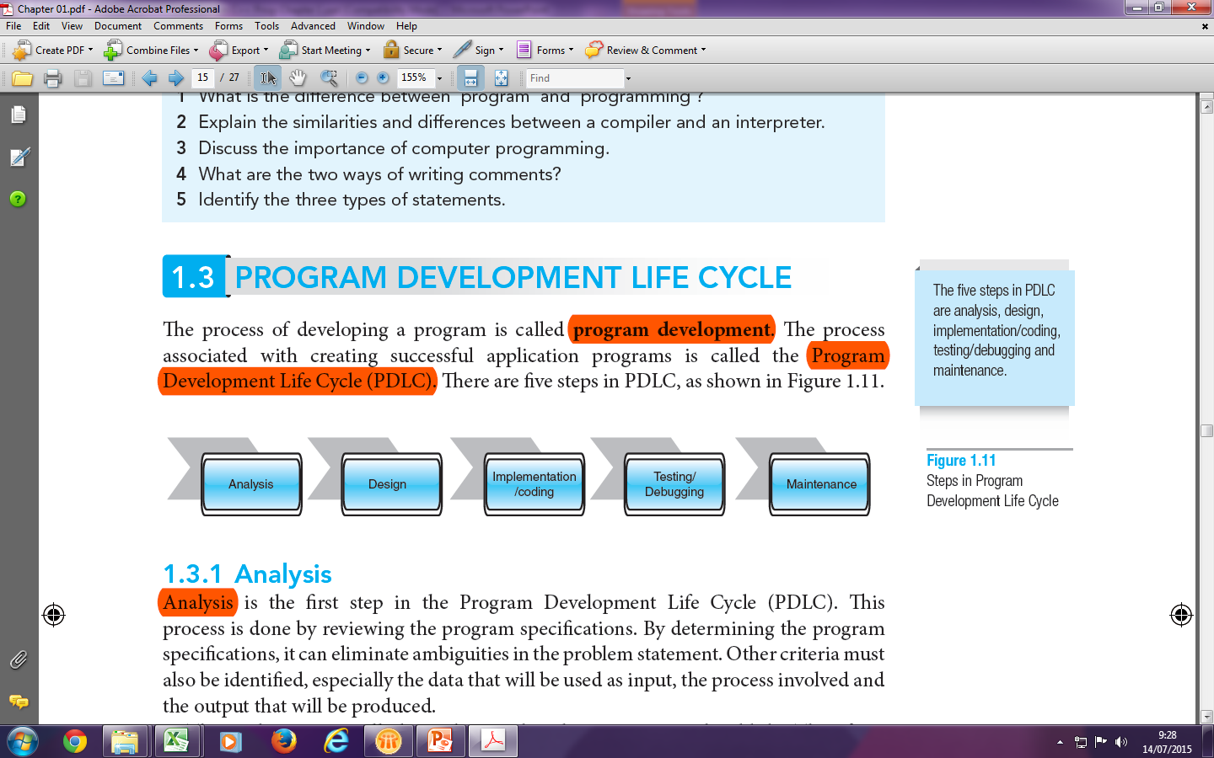
Program Development Life Cycle (PDLC) (1 of 12)
The process of developing a program is called program development.
The process associated with creating successful application programs is called the Program Development Life Cycle (PDLC).

Slide 17
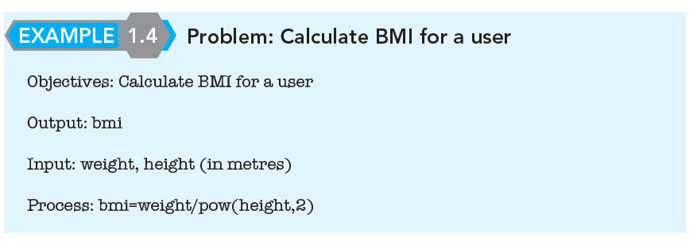
Program Development Life Cycle (PDLC) (2 of 12)
Analysis process is done by reviewing the program specifications.
Other criteria must also be identified, especially the data that will be used as input, the process involved and the output that will be produced.
Example

Slide 18
Program Development Life Cycle (PDLC) (3 of 12)
Design process is a programmer needs to develop a series of steps with the logic order, which when applied would produce the output of the problem.
There are two types of design for structured programming
  Algorithm
  Flowchart
  Pseudocode

Slide 19
Program Development Life Cycle (PDLC) (4 of 12)
    Algorithm is a set of step by steps problem solving process where the result is attained in a limited amount of time. Example
The C++ program is to calculate the payment that person received. Prompt input from user to enter hours work and salary rate per hour. Then, the system will automatically display employee name and the total salary per month.
Solution
    START / BEGIN
    READ/GET/INSERT/ENTER/INPUT the value of hour work.
    READ value of salary rate per hour
    CALCULATE/COMPUTE salary per month = (hours work * salary rate per hour) * 30
    DISPLAY/PRINT Salary per month.
    END/STOP

Slide 20
Program Development Life Cycle (PDLC) (5 of 12)
Flowchart is a graphic presentation of the detailed logical sequence of steps needed to solve programming problems.
Uses geometric symbols where different symbols are used to represent different actions such as start/stop, decision, input/output, processing and looping.
Keywords are written in uppercase, while variable and constant names as well as operations for the statements are written in lower case.

Slide 21
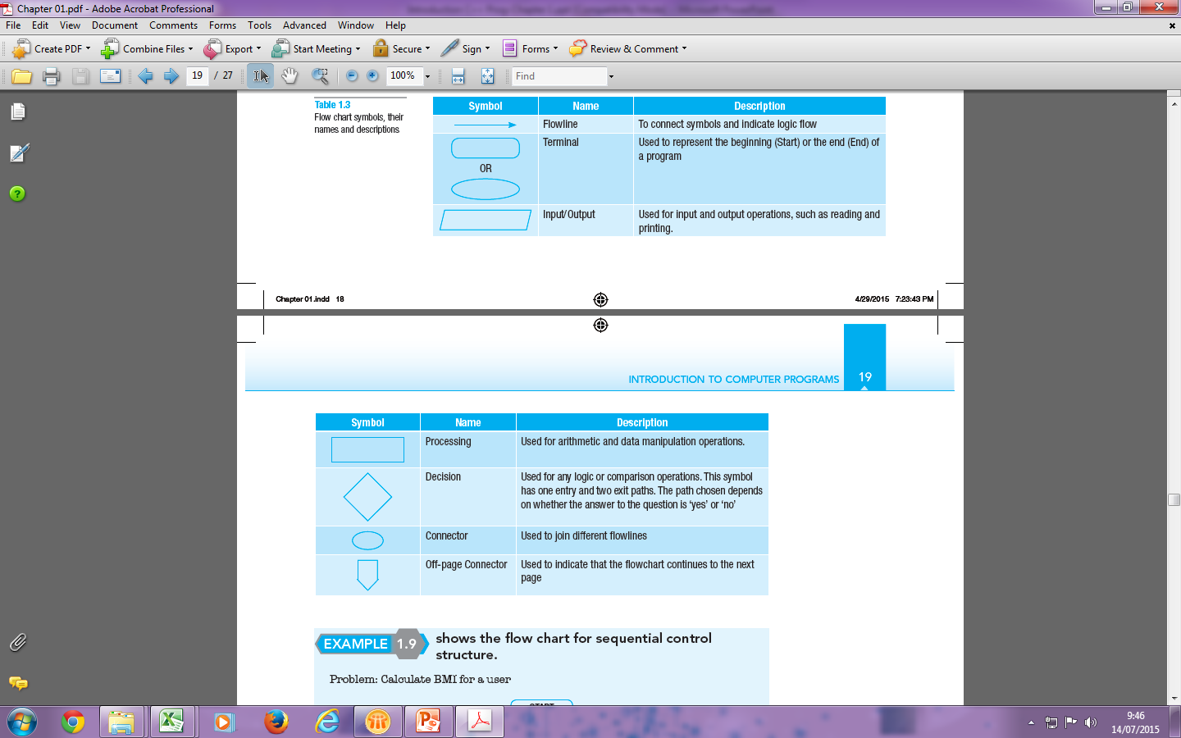
Program Development Life Cycle (PDLC) (6 of 12)

Slide 22
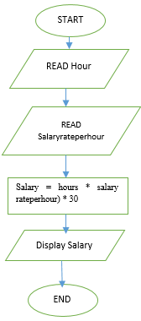
Program Development Life Cycle (PDLC) (7 of 12)
Example
The C++ program is to calculate the payment that person received. Prompt input from user to enter hours work and salary rate per hour. Then, the system will automatically display employee name and the total salary per month.

Slide 23
Program Development Life Cycle (PDLC) (8 of 12)
Pseudocode is a semiformal, English-like language with a limited vocabulary used to design and describe algorithms.
Every statement in pseudocode involves keywords which define the process and operands.
Each pseudocode statement should be written in a separate line.
Similar to flowchart, Keywords are written in uppercase, while variable and constant names as well as operations for the statements are written in lower case.

Slide 24
Program Development Life Cycle (PDLC) (9 of 12)
Example
The C++ program is to calculate the payment that person received. Prompt input from user to enter hours work and salary rate per hour. Then, the system will automatically display employee name and the total salary per month.
Solution:
  START / BEGIN
READ hour(int), Salaryrateperhour(double);
CALCULATE salary= (hours * salaryrateperhour) * 30;
DISPLAY salary(double);
END.

Slide 25
Program Development Life Cycle (PDLC) (10 of 12)
Implementation/coding process is converted the pseudocode which have been done in the design step into a program by using certain programming languages such as BASIC, JAVA, C or C++.
This step solves the problem by enabling the user to start writing the programs.

Slide 26
Program Development Life Cycle (PDLC) (11 of 12)
Testing is the step for checking and verifying the correctness of the program.
The process of making sure a program is free of errors or ‘bugs’ is called debugging.
Preliminary debugging begins after the program has been entered into the computer system.

Slide 27
Program Development Life Cycle (PDLC) (12 of 12)
Last step in the Program Development Life Cycle (PDLC) is Testing.
Essentially, every program, if it is to last a long time, requires ongoing maintenance.
A process of updating software for any changes, corrections, additions, moving to a different computing platform and others so that it continues to be useful.
A costly process.
Can be very useful especially on extending the life of a program.

Slide 28
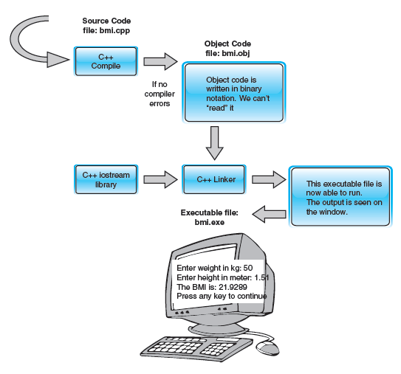
Processing a C++ Program (1 of 3)
The flow of program execution

Slide 29
Processing a C++ Program (2 of 3)
Steps needed to process a C++ program
  Use a text editor to create the source code (source program) in C++
  Include preprocessor directives
      Begin with the symbol # and are processed by the preprocessor
  Use the compiler to:
      Check that the program obeys the language rules
      Translate the program into machine language (object program)
  Use an integrated development environment (IDE) to develop programs in a high-level language
      Programs such as mathematical functions are available
      The library contains prewritten code you can use
      A linker combines object program with other programs in the library to create executable code
  The loader loads executable program into main memory
  The last step is to execute the program

Slide 30
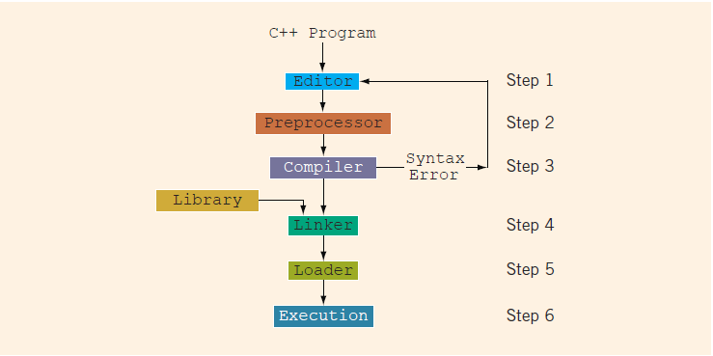
Processing a C++ Program (3 of 3)
FIGURE 1-2 Processing a C++ program

Slide 31
Importance of Computer Programming
  Able to perform difficult tasks without making human-type errors such as lack of focus, energy, attention or memory.
  Capable of performing extended tasks at greater serial speeds than conscious human thoughts.
  Human brain cannot be duplicated or ‘re-booted’ like computers, and has already achieved ‘optimization’ through design by evolution, making it difficult to upgrade.
  Human brain does not physically integrate well, externally or internally with current hardware and software.
  Non-existence of boredom in computers when performing repetitive tasks allows jobs to be done faster and more efficiently.

Slide 32
Summarize of Chapter 1
C++ program is called as source code or source program.
The program must be saved in a text file that has the extension .cpp.
For example, if you saved the preceding program in the file named FirstCPPProgram, then its complete name is FirstCPPProgram.cpp.

